Slide 1

Cranial morphology of dogs, bats, and primates
Molly Selba
PhD candidate at University of Florida

Slide 2
current work

Slide 3
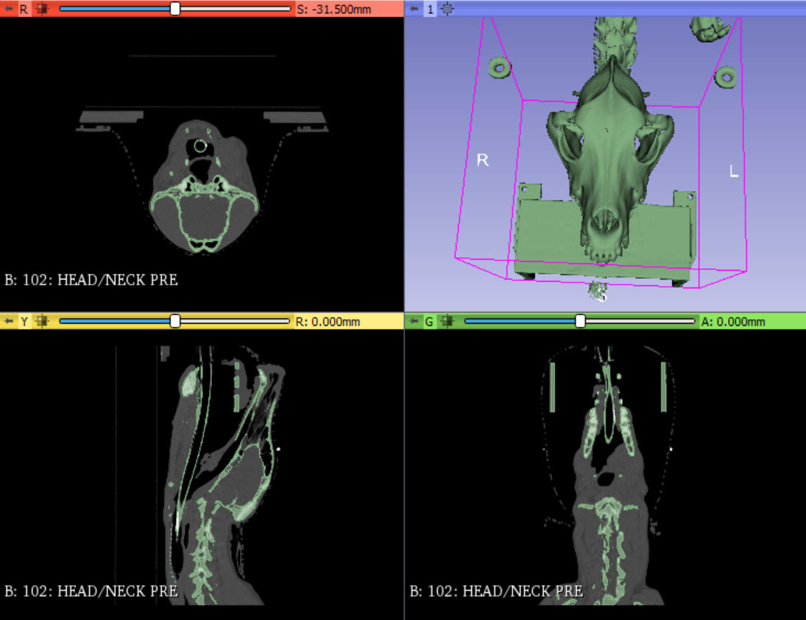
Amira to 3D slicer
Goals of using 3D Slicer:
Learn how to generate morphings for different PCs
Learn how to use the "Wrap Solidify" tool to generate endocasts
Learn how to use GM analysis tools included as part of 3D Slicer

